Slide 1
Summer 2022
Notes:
Welcome to the Summer 2022 Registration Workshop. This workshop will provide all MBA students with a general understanding of how to register for Summer 2022 courses.

Slide 2
Are you ready for registration?
Do I have a registration block?
No registration appointments for Summer. Registration is done on a first-come, first-served basis
Common reasons: Missing transcripts, immunization records, overdue bills and parking violations.
Registration Blocks:
Students should check their account for blocks and resolve by February 11.
Notes:
Are you ready for registration?
We reminded students in last week’s Weekly to clear any blocks. There are no exceptions and MPO cannot remove blocks on behalf of other University departments.
If you have not already checked for blocks, please check your cohort’s registration page on Networth and you will see that blocks is hyperlinked and it will take you to the Registration Appointment and Blocks page. This page has a lot of important information that I recommend you to read. On this page under Registration Blocks, you will see the instructions on how to check whether you have any blocks on your account.
Make sure to clear blocks PRIOR to registration. The most common registration blocks involve overdue bills. If your Spring tuition has not been paid for by yourself or a third party, there will likely be a hold on your account.

Slide 3
When is Summer Registration?
Tuesday, February 22,
7:30 a.m.
Clear any blocks prior to registration!

Slide 4
ACADEMIC CALENDAR
Summer is split into two terms: Summer I and Summer II
Summer I
Required or Recommended courses
One online elective
Summer II
Electives Only. Flex MBAs open to register for any Flex campus!
Review Curriculum per your campus and admit year
Fall 2019 Admit Curriculum Guide
Fall 2020 Admit Curriculum Guide
Fall 2021 Admit Curriculum Guide
Instructions are available on Networth under “Registration” on your respective campus homepage
Notes:
In the PT-Flex MBA program, the Summer Semester is divided into two parts, Summer I and Summer II. Summer I has required or recommended courses and one online elective option.
Summer II only has electives that are open Flex MBAs for any Flex campus!
Please review our admit year curriculum guide on Networth. These guides are extremely helpful in planning your graduation timeline. If you’re unsure whether an elective course is right for you, please contact me.

Slide 5
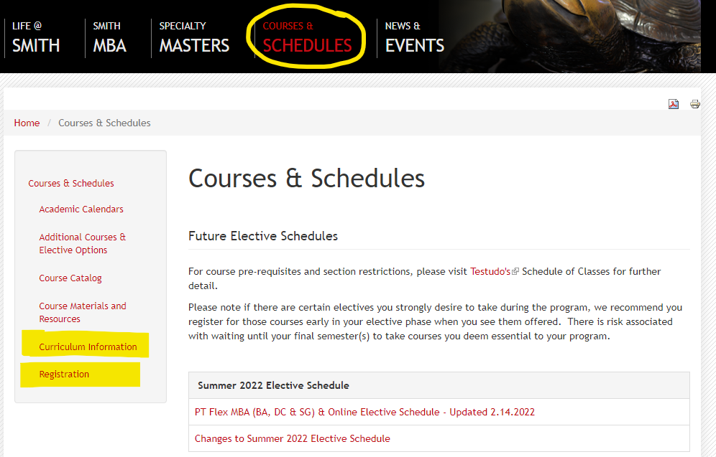
Notes:
So where do we find the Summer Elective Schedule? You can view this schedule directly when you click on the “Courses & Schedules” link at the top of Networth page. You can also get to that page from your cohort’s registration page.
Under Courses & Schedules on the left you will find two important links: Registration and Curriculum Information.
The registration instructions are very specific so please be sure to read through the page carefully.

Slide 6
How to Register for Summer I:
On Testudo: Select Summer I 2022
BUSI787 Integrative Capstone Section Number (Fall 2019 & 2020 Admits): DC11
BUSI758R Business Ethics Section Number (Fall 2019 & 2020 Admits): BA11, GS11, DC11 or DC12
Missed BUSI604 Business Communications? Make an appointment!
(Based on campus and cohort)
Notes:
If you were admitted in Fall 2019, you will be registering for either Closing Residency and/or Business Ethics in Summer I if you did not take them last year.
Fall 2020 Admits, you should be registering for your final two core classes: Closing Residency and Business Ethics.
Note that if you missed BUSI604 Business Communication, you will need to make an advising appointment with me. This class is no longer offered in the summer as a Flex MBA course.
Please follow the registration instructions listed on your registration page. If you run into any errors, please email me with a screenshot.

Slide 7
2019/2020 Admits
Summer I: May 23 - July 7
FINALS: July 8 - 10
BUSI787 Integrative Capstone/Closing Residency | BUSI758R Business Ethics
Same section for all: DC11 Saturday: June 4 Sunday: June 5 | Mondays: DC11 Tuesdays: DC12 Wednesdays: BA11 Thursdays: GS11
Summer II: July 11 - August 25
FINALS: August 26 - 28
Electives
Schedule depends on course selections.
Notes:
So here is what your schedule would look like for Summer I if you’re a Fall 2019/2020 Admit.
In Summer II, you are welcome to take your remaining elective courses at any offsite campus: BA, SG, DC. Please refer to the Summer Elective Schedule listed on Networth for available courses, paying close attention to section numbers. Students do not usually exceed 6 total credits in the summer sessions.
If you are completing your 54 credits in either Summer I or II, please note that you will be applying for graduation during the summer. MPO initially sends one reminder to all 2nd/3rd year students and then I will follow up with students accordingly.
Emphasize: Students who do not complete both parts of their graduation application will be delayed in their graduation process. This means students must apply for graduation in Testudo and also submit their Approved Program Form to me.

Slide 8
2021 Admits
Summer I: May 23 - July 7
FINALS: July 8 - 10
Business Decoded Saturday Seminars | BUSI641 Corporate Finance II - Recommended
View upcoming seminar dates in the Canvas site. * Note morning/afternoon sessions that overlap and point rubric provided by Paulo. | Mondays: BA11 Tuesdays: GS11 Wednesdays: DC11 Thursdays: DC12
Summer II: July 11 - August 25
FINALS: August 26 - 28
Electives
Schedule depends on course selections.
Notes:
Fall 2021 Admits should focus on attending Business Decoded seminars throughout summer. Note that there will be some additional sessions added to the Fall semester as well. Students getting close to completing either 25 or 50 hours for Business Decoded will register accordingly. MPO will send out more information during the summer so please stay tuned.
Some of you may may wonder why BUSI641 is recommended:
This term, BUSI640 introduces primary topics which includes valuation.
In BUSI641, you will delve more into the details of finance that you are likely to encounter in your careers. It’s recommended that you take both so that you have a fuller understanding of finance in various contexts.
In Summer II, you are welcome to take elective courses at any offsite campus: BA, SG, DC. Please refer to the Summer Elective Schedule listed on Networth for available courses, paying close attention to section numbers. Students do not usually exceed 6 total credits in the summer sessions. Please meet with me if you have any questions about your summer schedule.

Slide 9
How to Register for Summer II:
On Testudo: Select Summer I 2022
Please note that Summer II electives begin during the University's Summer I Term
Course Number: (For Example: BUSI730 )
Section Number: (For Example: BA21, GS21, or DC21)
Grading Method: Select Regular
Credits: 2
After course is added, click Submit Changes
Click View Schedule to confirm courses
Notes:
All Summer elective resources are available on Networth. Students should focus on the Networth Elective Schedule, as Testudo’s Schedule of Classes is updated immediately prior to registration. Any changes to the Elective Schedule will be noted on Networth under Courses and Schedules.
Registering for elective courses involves typing in the course and campus specific section number. Always reference the elective schedule posted on Networth for the most updated schedule of elective courses. You will see a number of electives offered in Summer II that are offered in-person and online.
Please note that Summer II electives begin during the University's Summer I Term. Therefore, to add a "Summer II" elective, please select the "Summer I" term in Testudo)
Please follow the registration instructions listed on your registration page. If you run into any errors, please email me with a screenshot.

Slide 10
Waitlists/Holdfiles
To join a waitlist, click “Add to Holdfile”
“Check In” the first day of classes on Testudo
Execute daily check-in to remain on waitlist
Waitlist Information on Networth
Waitlist How-To Video
Notes:
We highly recommend students add themselves to waitlists for courses they wish to take to demonstrate the true demand for courses.
Now, once a student adds themselves to a waitlist, starting the first day of classes for the University, they must execute daily waitlist check-ins online to remain on the waitlist.
If you do not execute daily waitlist check-ins after the start of classes, you will dropped from the waitlist. Note that a placement on the waitlist does not guarantee admittance to the course. You may be on more than one waitlist for different sections of the same course. If you waitlist multiple sections, the first section that becomes available is the one you will receive a seat in, and you will be dropped from all other waitlisted sections.
Please visit Networth’s Waitlist Information page to view the Waitlist How-To Video.
A very important note to remember: You cannot be registered for a course and be on a waitlist for another section of the same course.

Slide 11
Registration Issues
All campus advisors will be online and available by phone/email
7:30 a.m. on February 22 for Summer registration
Students are welcome to email/call
Please attach a screenshot of the error in your email
Have UID number handy
Your patience will be appreciated!
Notes:
To address and assist you in your registration, all campus advisors from BA, DC, and Rockville will be online and available by phone and email at 7:30 am on February 22 for summer registration to answer questions. Please understand that we will be responding to lots of phone calls and emails so your patience will be appreciated. If you run into any errors on your screen, it’s always helpful to send a screenshot so we can efficiently help you.

Slide 12
After Registration
Tuition and Fee Deadlines
Summer: March 20, 2022
View financial deadlines on Networth
Dropping Summer Courses for 100% Refund:
Summer I Courses:
Drop by Friday, May 20
Summer II Courses:
- Drop by Friday, July 8
Questions about billing or financial aid
smithfinancials@umd.edu
Notes:
Once you have registered for courses, it’s important to know the deadlines for tuition and fees. For summer, you are paying for both Summer I and II tuition by March 20, 2022.
Please note that if you are considering dropping any of your classes and wish to receive a 100% refund, to please do so up until the Friday before the term begins. This means, Friday, 5/20, is the last day to drop any Summer I courses. The last day to drop Summer II courses is on Friday, 7/8.
Please note that if you are considering dropping a class, we at MPO request that you drop the Friday before the semester/term begins for a 100% refund. Since our courses are non-standard, dropping classes beyond the first week means that you will only receive an 80% refund or less depending on the timing of the drop. Also, if you need to drop a core class, you will not be able to drop it as core classes can only be dropped by me. Of course this will require further conversation so please set up an advising appointment with me if you need to drop core or a number of classes in Summer.
If you have any questions about billing or financial aid, please email smithfinancials@umd.edu
Students who have questions that were not answered by this workshop should contact me prior to registration.
Good luck and thank you for attending today’s Registration Workshop!

Slide 13
Questions?

