Slide 1
SUPPLY CHAIN & OPERATIONS MANAGEMENT
A Brief Picture

Slide 2
What is…
Operations Management?
Supply Chain Management?
The practice of converting inputs (i.e. Materials, Labor, Capital) into goods and services in the most efficient way possible.
Managing the efficient flow of goods or services, information and money upstream to suppliers and suppliers’ suppliers and downstream to customers and customers’ customers

Slide 3
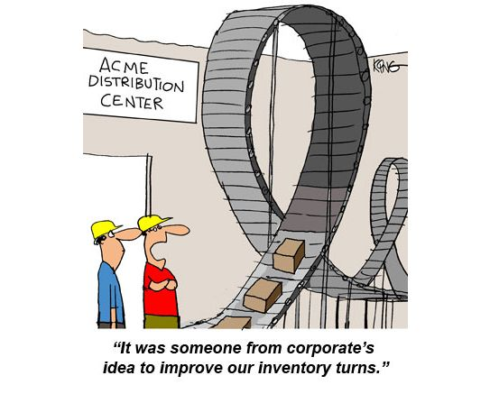

Slide 5
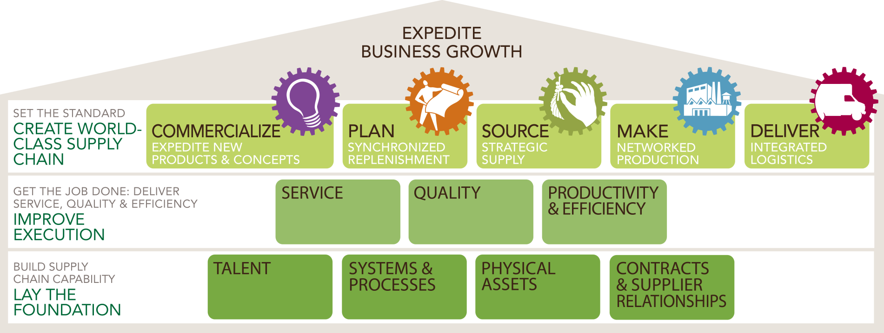
An SCM Strategic Framework
Courtesy of Peter D Gibbons
Notes:
Provide a quick snapshot of current trends that relate to your function

Slide 6




A picture is better than 1000 words!
How many words would be better than 3 pictures?
- A supply chain consists of:
Supplier
Manufacturer
Distributor
Retailer
Customer
Upstream
Downstream
- aims to Match Supply and Demand, profitably for products and services:
SUPPLY SIDE
DEMAND SIDE
+
+
+
+
+
=
The right
Product
The right
Price
The right
Store
The right
Quantity
The right
Customer
The right
Time
Higher
Profits
Courtesy of UT Dallas

Slide 8
A Week in the Life of a Supply Chain Operations Leader
Improve service
Lower cost
Launch new products
Develop people
Enhance reputation

Slide 9
The Role of the Global Supply Chain Leader
  Expedite the achievement of business goals
    Growth via products, channels, geographies, brands
    Profit via costs, margins, price
  Ensure world-class customer fulfillment
    Perfect order and quality
    Current and new products/markets/channels
  Enhance our brands and reputation
    Quality, safety, compliance, ethical sourcing, sustainability, social responsibility
This is done by retaining and developing the best talent and must result in a competitive cost advantage.

Slide 10
Industries Supporting Supply Chain & Operations Positions
Government & Defense
Consulting
Consumer Product Goods (CPG)
Logistics and Transportation
Construction
Energy
Manufacturing
Aerospace
Technology
Hospitality/Healthcare/
Pharma

Slide 11

Types of Positions in Supply Chain & Operations
Demand, Supply or Production Planning Manager
Logistics, Distribution or Transportation Manager
Commercialization Manager
Inventory Control Manager
Global Sourcing or Purchasing Manager
Merchandise Manager

